Slide 1
BusRider App
Team Name: Tech Team_Returns
Domain Name: Transport
Problem Statement: How to make people use public transport and also promote carpooling.
Solution: Automated ticketing and bus ride tracker.

Slide 2
Problem Identification
It has been observed that one of the main reasons for daily commuters to not avail public transits is the UNCERTAINTY that comes with it.
Excessive wait time.
Missed trip due to wrong information
Passed up due to overcrowding
Irregular schedules.

Slide 3
Proposed Solution
We create a new web application called BusRider app to solve these problems,
The BusRider app is an app which keeps track of the track of number of passengers in the bus.
It also helps to maintain an online ticketing system for both the passengers and the driver.
It also tells what bus to take to travel each route.

Slide 4
Solution Features

Slide 5
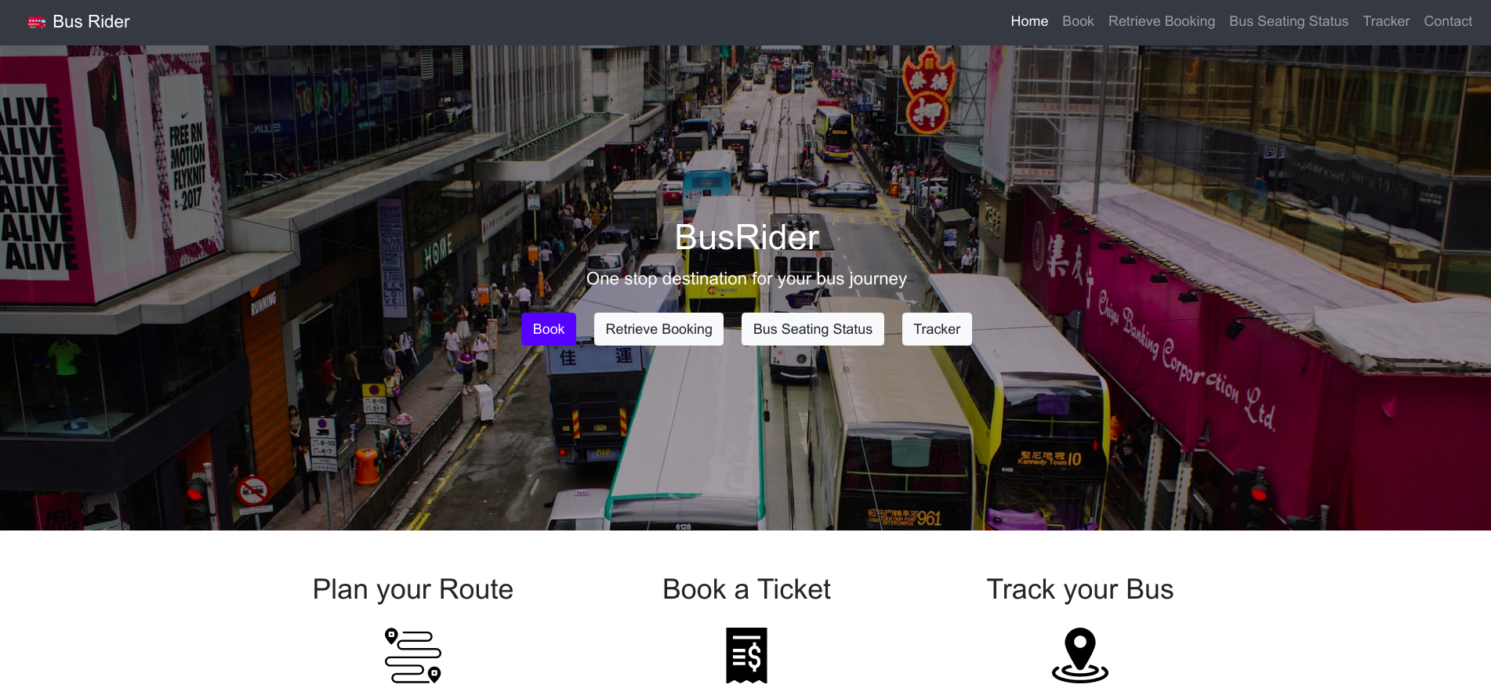
Bus Booking and Tracking Platform

Slide 6
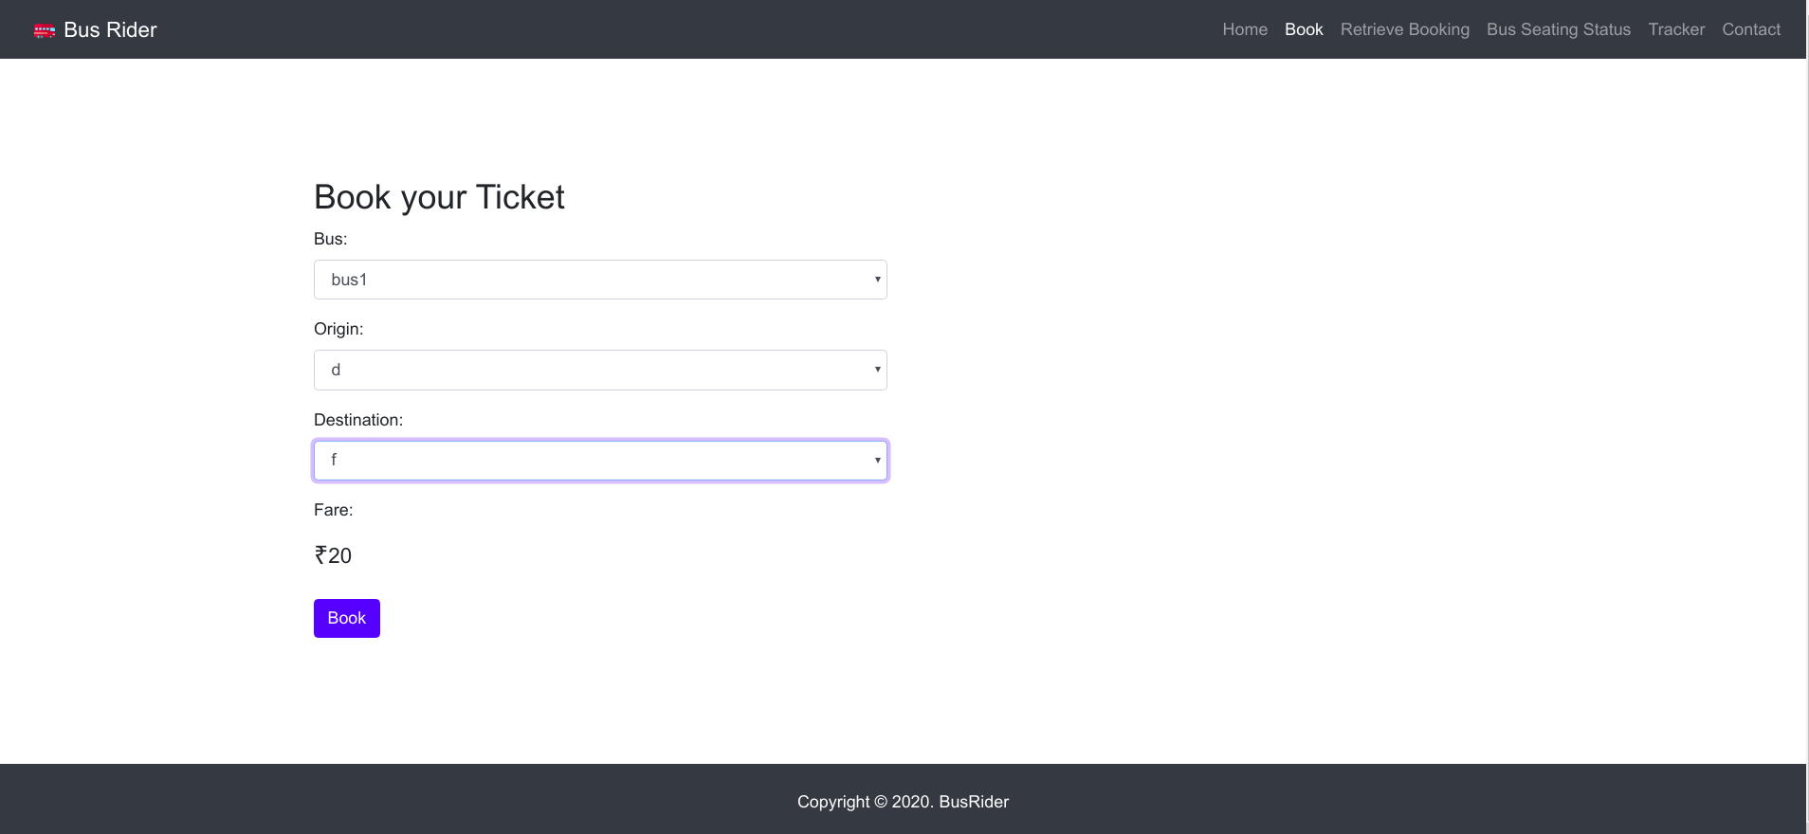
Book Tickets

Slide 7
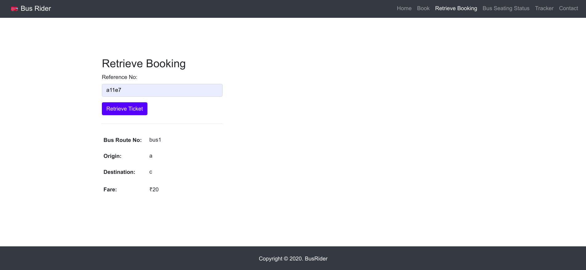
See Booking Status

Slide 8
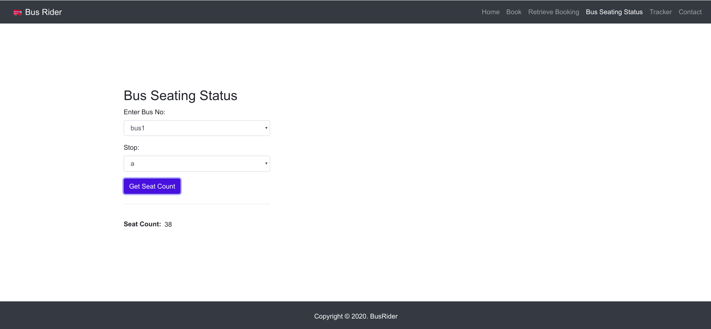
Bus Seating Status

Slide 9
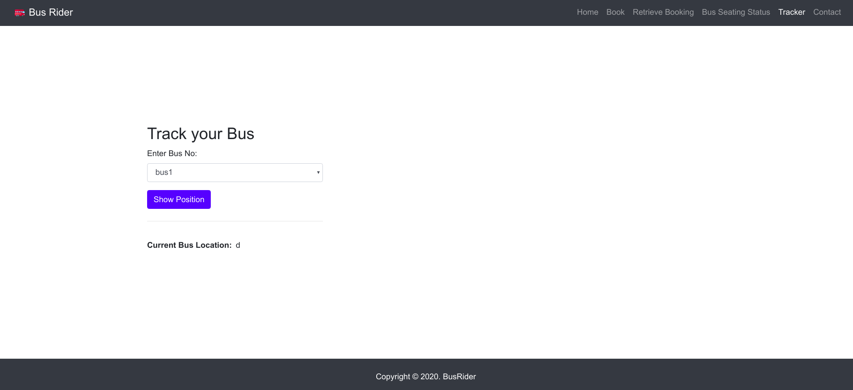
Bus Tracking

Slide 10
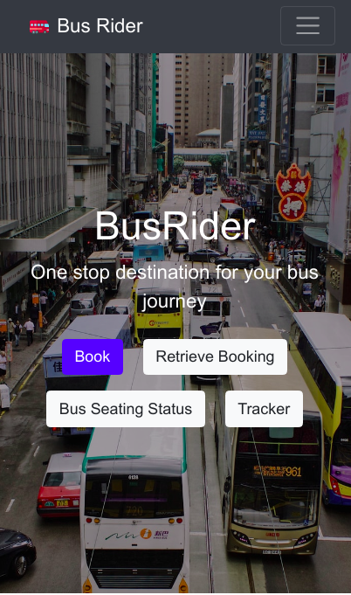
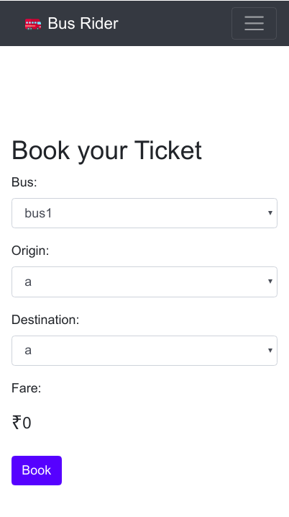
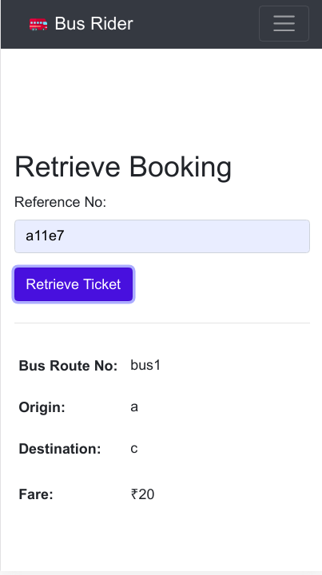
Mobile Friendly

Slide 11
On-Demand Transport

Slide 12
On-Demand Transport
The on-demand economy is a new paradigm in which economic entities provide on-demand services to others. The modern economy is fuelled by a demand for instant gratification. It aims to provide an immediate response to the demands of the consumer, by bringing opposing parties in the supply chain closer together, and building transport infrastructure around the customer experience.
Thanks to the Internet, consumer behavior has changed, with convenience becoming a critical influence on purchase decisions. A central part of the on-demand economy is on-demand transport services.
On-demand transportation apps can process payments instantly and give consumers access to a car, e-scooter or bicycle in minutes, using nothing more than their mobile phones.

Slide 13
On-Demand Transport
With the proliferation of mobile devices and applications, more people are choosing on-demand transportation services. Some of the trends becoming popular are:
Ride-hailing: An online platform connects passengers in need of a ride with nearby drivers heading the same way. Rides are booked via an application.
Ridesharing: People who seek one-way rides can find available seats offered by drivers going in the same direction. An online platform provides ride-matching software connecting car owners with passengers.
Carpooling: Rides are exchanged between family and friends who take turns using their cars to transport the group. Employees use this system to share rides to work as well as parents taking turns to transport their children.

Slide 14
Business Model

Slide 15

Business Model
Monthly fees from bus owners and drivers.
Charging a fee from bus owners to be featured on our platform.
Taking a small cut from the ticket sales.
Charging a premium fee for getting booked on a less crowded bus.
Showing advertisements on our platform.
Eventually partnering with other forms of transportation.

Slide 16
Tech Stack

Slide 17

Tech Stack
We use the following Tech Stack for our application:
Python + Flask - as backend server
SQLite3 Database - database for our application
SQLAlchemy - an interface between Python and the SQLite3 database.
Bootstrap - for responsive frontend.

Slide 18

Flask
Flask is a web framework. This means flask provides you with tools, libraries and technologies that allow you to build a web application. This web application can be some web pages, a blog, a wiki or go as big as a web-based calendar application or a commercial website.
Flask is part of the categories of the micro-framework. Micro-framework are normally framework with little to no dependencies to external libraries.

Slide 19

SQLite
SQLite is a relational database management system (RDBMS) contained in a C library. In contrast to many other database management systems, SQLite is not a client–server database engine. Rather, it is embedded into the end program.
SQLite is a popular choice as embedded database software for local/client storage in application software such as web browsers. It is arguably the most widely deployed database engine.

Slide 20

SQLAlchemy
SQLAlchemy is the Python SQL toolkit and Object Relational Mapper that gives application developers the full power and flexibility of SQL.
It provides a full suite of well known enterprise-level persistence patterns, designed for efficient and high-performing database access, adapted into a simple and Pythonic domain language.
SQL databases behave less like object collections and more like tables and rows. SQLAlchemy aims to accommodate both of these principles.

Slide 21
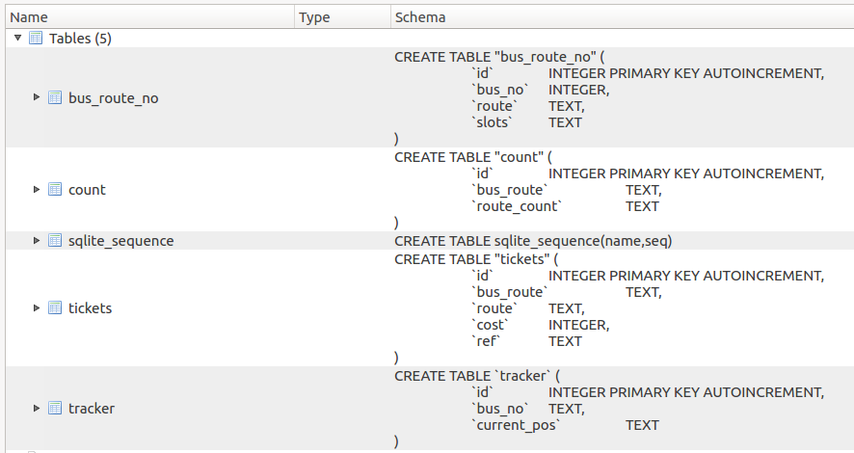
Database Schema

Slide 22
Team Members:
Shoumik Dey - shoumikdey123@gmail.com
Arya Das - aryadas98@gmail.com
Rishab Ghosh - rishabghosh1222@gmail.com

Slide 23
Team Members:
The End
Shoumik Dey - shoumikdey123@gmail.com
Arya Das - aryadas98@gmail.com
Rishab Ghosh - rishabghosh1222@gmail.com

